Slide 1
Programming Fundamentals
Solidity Fundamentals
Web3 Development for Beginners

Slide 2
What is Solidity?
Was invented specifically for smart contracts
Powers EVM blockchains
Is fairly similar to Javascript

Slide 3
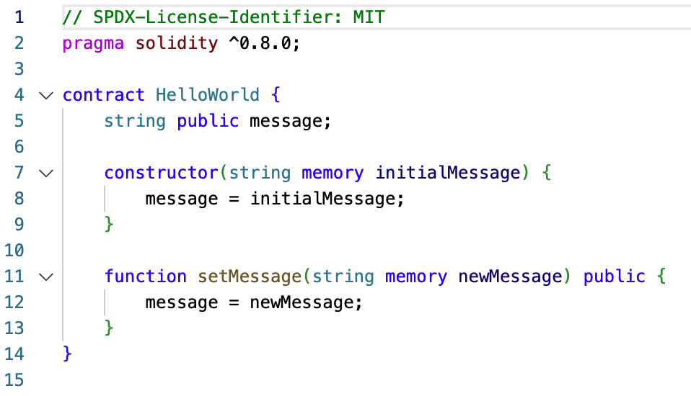
What does Solidity look like?

Slide 4
Some coding basics: Contract
Self-contained, reusable
Deployable
Has a current state
Own address, own storage

Slide 5
Some coding basics: Variable Types
bool: A boolean value, representing true or false.
uint: An unsigned integer, which can only store non-negative integer values.
int: A signed integer, which can store both positive and negative integer values.
address: Represents an Ethereum address, which is a 20-byte identifier used for accounts and smart contracts.
bytes: A fixed-size byte array, where the size is specified with a suffix (e.g., bytes1, bytes2, ..., bytes32).
string: A dynamically-sized string, which is a UTF-8 encoded sequence of characters.
mapping: A key-value store (similar to a hash table) that associates one data type with another (e.g., mapping(address => uint)).
struct: A user-defined composite data type that groups related variables together (e.g., struct Person {string name; uint age;}).
enum: A user-defined data type with a finite set of predefined constant values (e.g., enum State {Created, Active, Finished}).
array: A collection of elements of the same data type, which can be fixed-size or dynamically-sized (e.g., uint[] for a dynamic array of unsigned integers, or uint[5] for a fixed-size array with 5 elements).

Slide 6
A note about floating point numbers
Tricky in many programming languages
Workaround, including in Solidity: Use integer numbers that include the decimals. E.g. 10000 = 100.00 and 10020 = 100.20

Slide 7
Let’s check it out

Slide 8
Some coding basics: Interface
Define function signatures without implementation
Facilitate interaction between contracts
Enforce specific structure through inheritance
Restrict to external functions, no state variables or constructors
Commonly used for standard specifications (e.g., ERC20, ERC721)

Slide 9
Let’s check it out

Slide 10
Some coding basics: functions
Define functions with the function keyword, followed by the function name, parameters, visibility, and return type (if applicable).
Function visibility: public (callable by anyone), external (callable from other contracts), internal (callable within the contract and derived contracts), or private (callable only within the contract).
Use the view modifier for read-only functions that do not modify the contract state.
Use the pure modifier for functions that do not access nor modify the contract state.
Functions can return values using the returns keyword followed by the return type.
Use the return keyword to specify the value(s) returned by a function.
Functions can accept Ether by adding the payable modifier.
Functions can emit events to log state changes or notify external consumers.
Use function modifiers to apply reusable checks or functionality before or after the function execution.
Overload functions by defining multiple functions with the same name but different parameter types or counts.

Slide 11
Let’s check it out

Slide 12
Some coding basics: import
Use import keyword with file paths
Support for relative and absolute paths
Imported elements available in current scope
Aliasing with as keyword
Import specific elements with curly braces {}
Import from popular libraries (e.g., OpenZeppelin)
Path remappings for shortcuts and aliases

Slide 13
Let’s check it out

Slide 14
Recap
Solidity has various variable types
Solidity has functions to interact with those types
Solidity can inherit, define interfaces and contracts
Solidity is fun :)

